Slide 1
Employee Management
Maxwell Phiri
Notes:
Brief Intro About
Developer and Finchoice
Develop -> Family Cover, Personal Cover, Parent Cover
The technology we use is different – older
Structures are also different
For this solution I have chosen to use Tech that I have been learning and what is currently exciting me

Slide 2
The Problem
A web-based application that shows staff relationships to a minimum of 3 levels e.g.
Manager
Team Lead
Developer
The application should provide:
log in capabilities, with different privileges
a list of all employees
ability to search for an employee
the ability to edit any employee
the ability to show the relationships between the selected employee and their superiors and/or staff

Slide 3
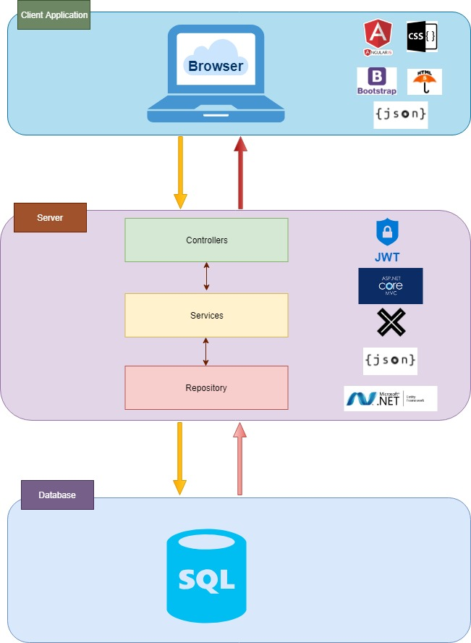
Solution and Tech Stack Overview
Notes:
What type of connections do we have between the Client Side and Server side and Database
Used Angular 1 – because of familiarity
Used .net Core because of
In built capabilities to handle dependency injection
It is easy to deploy on different operating systems
Built for Testability
It is light weight and Modular
Entity Framework – Used it with fluent
- Used Code First, there by allowing it to handle my db
- Used JWT it is easy to get my head around (Token Authentication)

Slide 4
Basic Architecture
Core
Presentation
Core
Application
Domain
Persistence
Notes:
Clean Architecture is:
Modern SW Architecture
Simple
Understandable
Maintainable
Testable

Slide 5
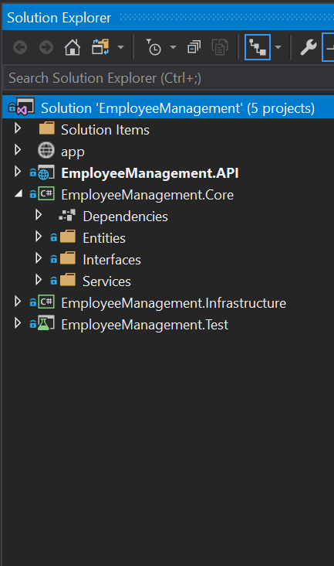
Basic Architecture
Core
Presentation
Core
Application
Domain
Persistence

Slide 6
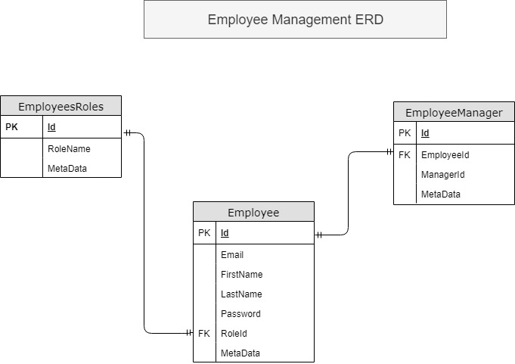
DB Structure

Slide 7
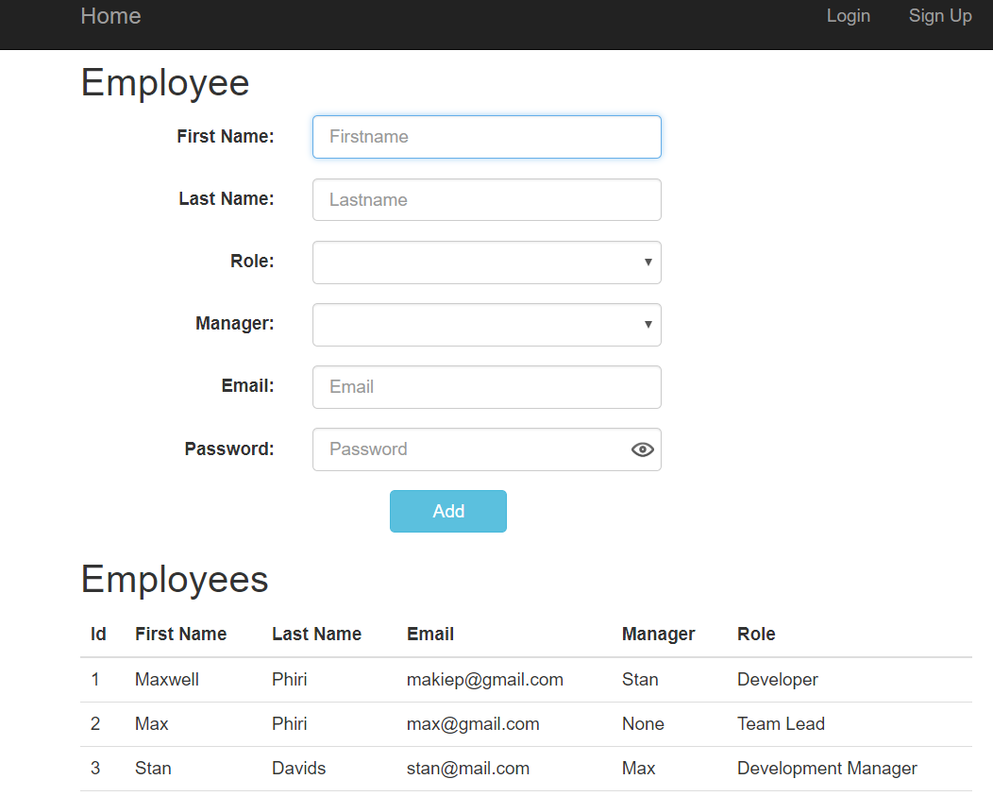
Demo

Slide 8
Thank You!
Maxwell Phiri

